Slide 1
Polarizers
Reading – Shen and Kong – Ch. 3
Outline
Review of the Lorentz Oscillator
Reflection of Plasmas and Metals
Polarization of Scattered Light
Polarizers
Applications of Polarizers

Slide 2
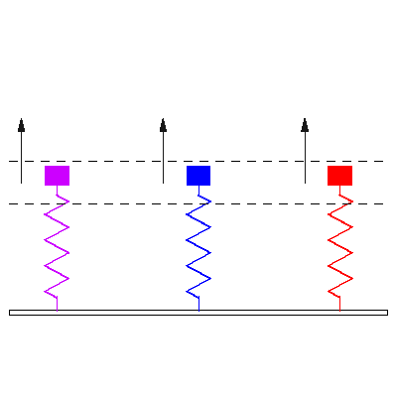
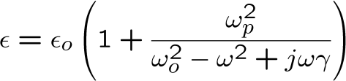

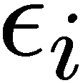

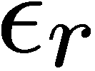

Microscopic Lorentz Oscillator Model

Slide 3





Complex Refractive Index
Note: we just changed notation from n to nr
(real)
(imaginary)
Notes:
Note:

Slide 4
Plasmas (which we will assume to be lossless, )
… have no restoring force for electrons,
Reflecting
Transparent
1.0
0.5
for
0
for
If ε < 0 then n is imaginary
-0.5
1
1.5
2

Slide 5
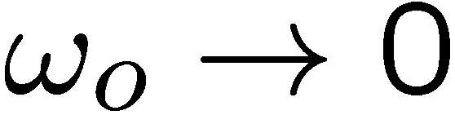

Metals are Lossy
… and have no restoring force for electrons
Reflecting
Transparent
1.0
0.5
-0.5
-1.0
0.5
1.0
1.5
2.0
2.5
© Kyle Hounsell. All rights reserved. This content is excluded from our Creative Commons license. For more information, see http://ocw.mit.edu/fairuse.

Slide 6
Give an argument that proves
that a truly invisible man would also be blind

Slide 7
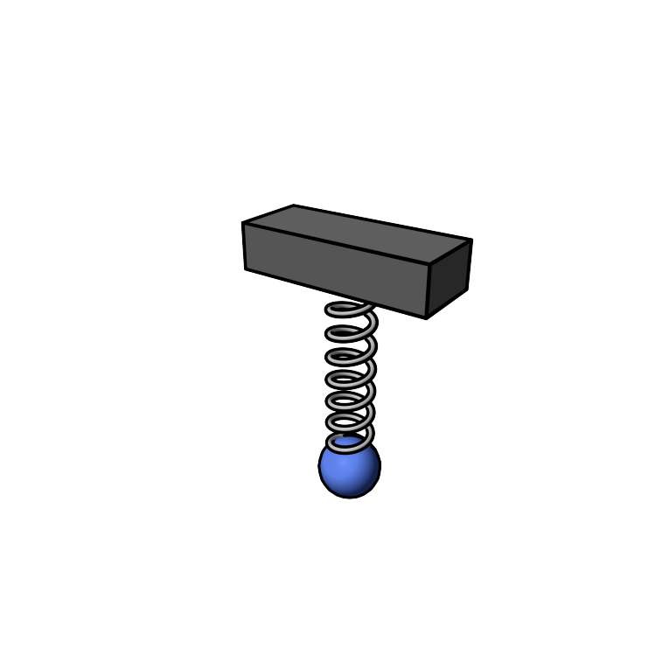
Effect of Sinusoidal E-field on a Hanging Charged Ball

Slide 8
Radiation of a Moving Charge
Incident waves
Re-radiated waves
Incident + re-radiated waves

Slide 9
Why is Skylight Polarized ?
Air
molecules
Sun

Slide 10



clear day
moderate haze
very hazy
Why did Mountains Turn Bluish ?
Because atmosphere preferentially scatters blue light
www.hazecam.net
© Northeast States for Coordinated Air Use Management (NESCAUM) . All rights reserved. This content is excluded from our Creative Commons license. For more information, see http://ocw.mit.edu/fairuse.

Slide 11
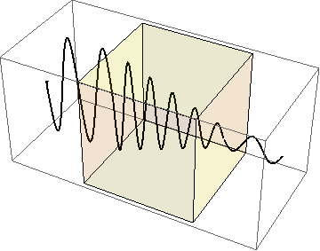
Behavior of Plane Waves in Lossy Materials
… can help us understand polarizers
1.0
0.5
0
-0.5
-1.0
1
2
3
4
5
6

Slide 12
Wire-grid Polarizer
… converts an unpolarized beam into one with a single linear polarization
The wire-grid polarizer consists of a regular array of parallel
metallic wires, placed in a plane perpendicular to the incident beam.
Electromagnetic waves with electric fields aligned parallel to the wires induce the movement of electrons along the length of the wires. Since the electrons are free to move, the polarizer behaves in a similar manner as the surface of a metal when reflecting light; some energy is lost due to Joule heating in the wires, and the rest of the wave is reflected backwards along the incident beam.
Electromagnetic waves with electric fields aligned perpendicular to the wires, the electrons cannot move very far across the width of each wire; therefore, little energy is lost or reflected, and the incident wave is able to travel through the grid.
Therefore, the transmitted wave has an electric field purely in the direction perpendicular to the wires, and is thus linearly polarized.

Slide 13
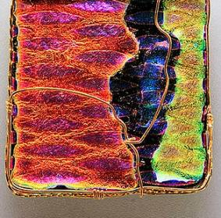
Image by zygzee http://www.flickr.com/photos/zygzee/324322772/ on flickr
Dichroism of Materials
Dichroism in materials refers to the phenomenon when light rays having different polarizations are absorbed by different amounts.
Polaroid sheet polarizers were developed by Edwin Land
in 1929 using herapathite. Herapathite, or iodoquinine
sulfate, is a chemical compound whose crystals are dichroic
and thus can be used for polarizing light.
According to Edwin H. Land, herapathite was discovered In 1852 by William Herapath, a doctor in Bristol. One of his pupils found that adding iodine to the urine of a dog that had been fed quinine produced unusual green crystals. Herapath noticed while studying the crystals under a microscope that they appeared to polarize light.
Land in 1929 to construct the first type of Polaroid sheet polarizer. He did this by embedding herapathite crystals in a polymer instead of growing a single large crystal. Land established Polaroid Corporation in 1937 in Cambridge, Massachusetts. The company initially produced Polaroid Day Glasses, the first sunglasses with a polarizing filter.
dichroic glass jewelry

Slide 14
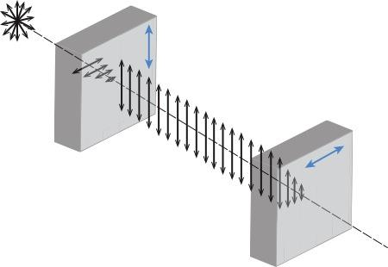
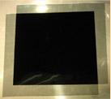
Crossed Polarizers
In practice, some light is lost in the polarizer and the actual transmission of unpolarized light will be somewhat lower than this, around 38% for Polaroid-type polarizers.
If two polarizers are placed one after another (the second polarizer is generally called an analyzer), the mutual angle between their polarizing axes gives the value of θ in Malus' law. If the two axes are orthogonal, the polarizers are crossed and in theory no light is transmitted, though again practically speaking no polarizer is perfect and the transmission is not exactly zero (for example, crossed Polaroid sheets appear slightly blue in color).
Real polarizers are also not perfect blockers of the polarization orthogonal to their polarization axis; the ratio of the transmission of the unwanted component to the wanted component is called the extinction ratio, and varies from around 1:500 for Polaroid to about 1:10⁶ for Glan-Taylor prism polarizers.
Unpolarized
light
Linearly
polarized light
Transmission
axis

Slide 15
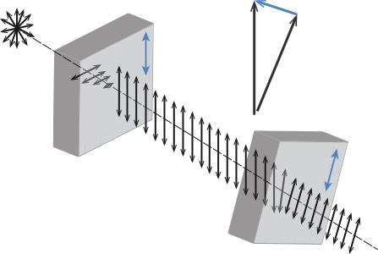
Malus' law, discovered experimentally by Etienne-Louis Malus in 1809, says that when a perfect polarizer is placed in a polarized beam of light, the intensity, I, of the light that passes through is given by
Where is the initial intensity, and θ is the angle between the light's initial plane of polarization and the axis of the polarizer.
Absorbed
component
Transmission
axis
Question:
Two polarizing sheets have their polarizing directions parallel, so that the intensity of the transmitted light is maximized (with value ). Through what angle, θ, must either sheet be turned, if the transmitted light intensity is to drop to ½ ?
θ = ______________

Slide 16
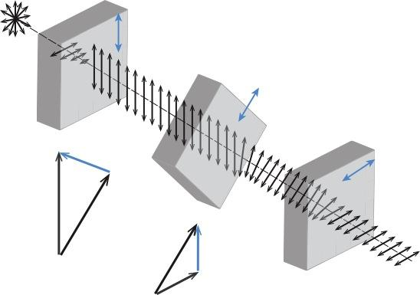
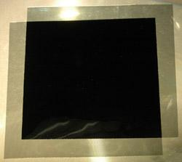
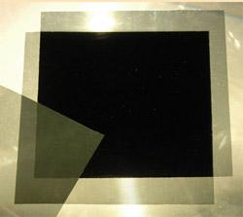
Polarizer Puzzle
If crossed polarizers block all light, why does putting a third polarizer at 45° between them result in some transmission of light?
Transmission
axis
Absorbed
component
Absorbed
component
Transmitted component

Slide 17
Polarized Sunglasses
Light waves polarized
perpendicular to the highway
Light waves polarized
parallel to the highway
Reduce glare off the roads while driving

Slide 18
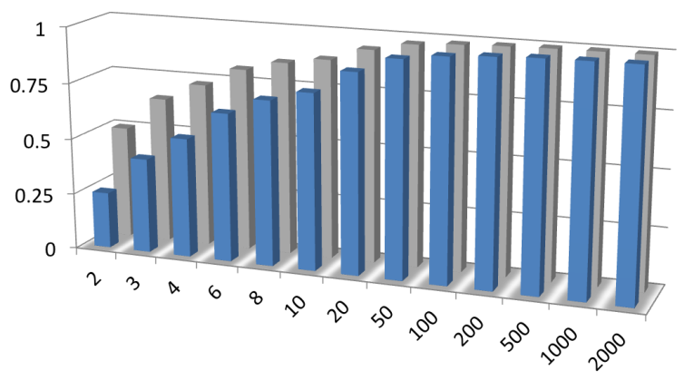
Transmission Through a Stack of Polarizing Sheets
We assumed that these polarizers have no absorption
E-field
Intensity
N, Number of Polarizing Sheets
Polarization of each is turned by π/(2N)
with respect to the previous one in a stack

Slide 19


Polarization Photography
Without Polarizer
With Polarizer
Reduces Sun Glare
Reduce Reflections
Darkens Sky
Increase Color Saturation
Reduces Haze

Slide 20


Polarization Photography : Reflections
Reduce Reflections

Slide 21
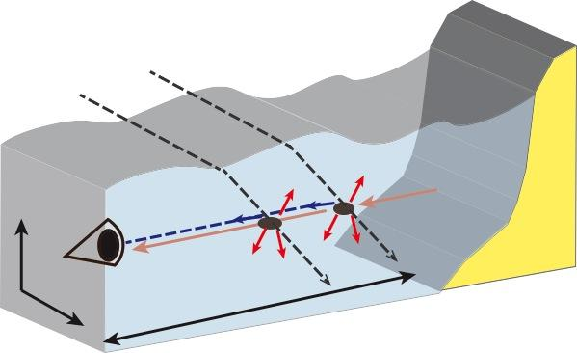
Polarization Photography : Underwater
Natural
illumination
Water surface
Object
radiance
veiling
light
signal
camera

Slide 22
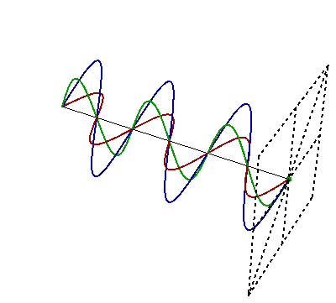
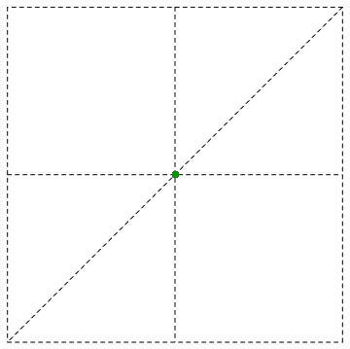
Superposition of Sinusoidal Uniform Plane Waves

Slide 23
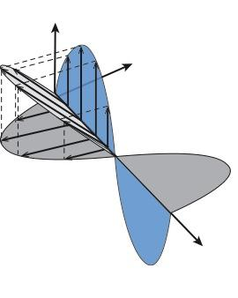
45° Polarization
The complex amplitude,
,is the same for both components.
Therefore and are always in phase.
Where is the magnetic field?

Slide 24
Arbitrary-Angle Linear Polarization
E-field variation over time
(and space)
y
Here, the y-component is in phase
with the x-component,
but has different magnitude.
x

Slide 25

Arbitrary-Angle Linear Polarization
Specifically:
0° linear (x) polarization: E_{y} /E_{x} = 0
90° linear (y) polarization: E_{y} /E_{x} = ∞
45° linear polarization: E_{y} /E_{x} = 1
Arbitrary linear polarization:

Slide 26
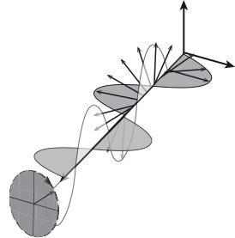
Circular (or Helical) Polarization
… or, more generally,
The complex amplitude of the x-component is -j times the complex amplitude of the
y-component.
E_{x} and E_{y} are always
90 ͦ out of phase
The resulting E-field rotates
counterclockwise around the
propagation-vector
(looking along z-axis).
If projected on a constant z plane the
E-field vector would rotate clockwise !!!

Slide 27

Right vs. Left Circular (or Helical) Polarization
E-field variation over time
(at z = 0)
… or, more generally,
Here, the complex amplitude
of the x-component is +j times
the complex amplitude of the
y-component.
So the components are always
90 ͦ out of phase, but in the other direction
The resulting E-field rotates
clockwise around the
propagation-vector
(looking along z-axis).
If projected on a constant z plane the E-field vector would rotate counterclockwise !!!

Slide 28
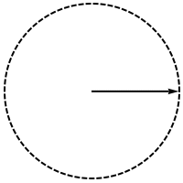
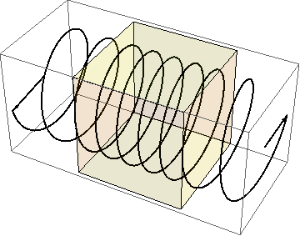
Effect of the refractive index of the medium on circularly polarized radiation

Slide 29
A linearly polarized wave can be represented as a sum of two circularly polarized waves

Slide 30
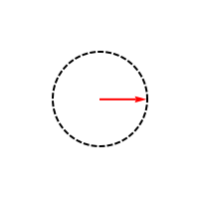
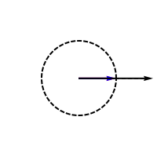
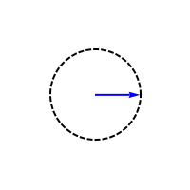
A linearly polarized wave can be represented as a sum of two circularly polarized waves
CIRCULAR
LINEAR
CIRCULAR

Slide 31


Unequal arbitrary-relative-phase components yield elliptial polarization
E-field variation over time
(and space)
where
… or, more generally,
The resulting E-field can rotate clockwise or counter-clockwise around the k-vector (looking along k).
… where are arbitrary
complex amplitudes

Slide 32
EM Waves can be linearly, circularly, or elliptically polarized.
A linearly polarized wave can be represented as a sum of two circularly polarized waves.
Key Takeaways
Plasmas – lossless, no restoring force
Metals – lossy, no restoring force
Dielectrics – lossy, with restoring force
EM Field of light causes vibration of the matter it interacts with. The mater is polarized along the same direction as the EM wave … leading to re-radiation of light by polarized matter. (This is why skylight is polarized.)
Malus' law: when a perfect polarizer is placed in a polarized beam of light, the intensity, I, of the light that passes through is given by
where I₀ is the initial intensity, and θ is the angle between the light's initial plane of polarization and the axis of the polarizer.

Slide 33
MIT OpenCourseWare
http://ocw.mit.edu
6.007 Electromagnetic Energy: From Motors to Lasers
Spring 2011
For information about citing these materials or our Terms of Use, visit: http://ocw.mit.edu/terms.

